Slide 1
Minor Project -I :– B.Tech(CSE, V Sem) Topic: AI Interview Chatbot Guided by: Dr. K.B. Meena Team Members(KBM4) Yash Singhal -231B405 Yash Khandewal-231B401 Arpita Nayar-231B446

Slide 2
Problem Statement
Students often lack structured practice for interviews.
Existing tools are either generic or not interactive.
Difficulty levels and domains are not personalized.
There is a gap in providing real-time feedback and improvement tracking.

Slide 3
Introduction
Preparing for interviews can be stressful and unstructured.
Our idea: an AI-based chatbot that simulates interviews.
It will ask questions, adapt difficulty, and provide feedback.
Current stage: Research, analysis, and project planning.

Slide 4
Technology Exploration
Programming Language: Python
Libraries Studied: NLTK, Scikit-learn, Pandas, Kaggle API
Tools Considered: VS Code, Kaggle datasets
Concepts Reviewed: NLP basics, tokenization, scoring methods, SDLC models.
DATASET - “Data Science Interview Questions (FAANG & Top Companies)” (2018–2022)

Slide 5
DATASET
Source: Kaggle – “Data Science Interview Questions (F (2018–2022)”
Contains 111+ real interview questions .
Covers domains: ML, DL, Statistics, EDA.
Questions categorized by difficulty (Easy, Medium, Hard).
IMPLEMENTING OF DATA SET IN VARIOUS STEP
Dataset fetched via Kaggle API (JSON).
• Machine Learning • Deep Learning
Tools: (data handling), NLTK

Slide 6
OBJECTIVE
Provides a safe, stress-free environment for interview practice.
Adapts difficulty based on learner’s progress.
Offers instant feedback using NLP techniques.
Bridges gap between theory preparation and real interview scenarios.

Slide 7
What We Aim to Build
A chatbot that:
Conducts mock interviews in chosen field
Uses NLP to analyze answers
Provides constructive feedback to learners
Mock Interview in Chosen difficulty level.

Slide 8
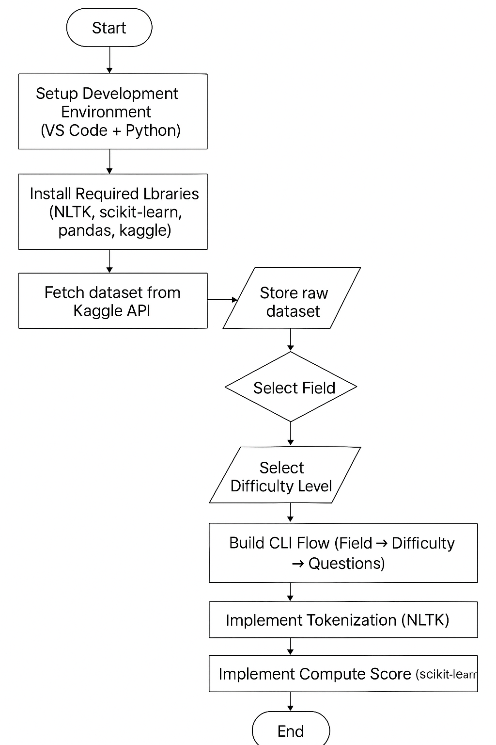
PROJECT WORKFLOW
1. Setup environment (VS Code + Python)
2. Collect dataset (Kaggle API)
3. Clean & preprocess data
4. Define interview flow (field → difficulty → question)
5. Apply NLP techniques (tokenization, scoring)
6. Integrate components into chatbot

Slide 9
Iterative Process in Model Construction
Step-by-step Refinement: The model is not built in one go; it improves gradually.
Iteration = Repetition: Training happens in multiple cycles (epochs).
Input → Process → Feedback → Update.
Goal: Reduce errors with every iteration.
Outcome: A well-trained model that generalizes to new data.

Slide 10
Planned Workflow
1. Setup environment (VS Code + Python)
2. Collect dataset (Kaggle API)
3. Clean & preprocess data
4. Define interview flow (field → difficulty → question)
5. Apply NLP techniques (tokenization, scoring)
6. Integrate components into chatbot

Slide 11
CONCLUSION
- Reviewed research papers and existing solutions
- Identified key concepts, limitations, and approaches
- Studied NLP foundations and SDLC models
- Designed workflow & flowchart for chatbot development
- Explored dataset sources for interview Q&A

Slide 12
Future Work
- Start actual implementation & coding
- Enhance chatbot with voice-based interaction
- Expand dataset for multiple domains
- Deploy as web or mobile application

Slide 13
LIMITATION OF OUR MODEL
Pre-stored dataset dependency – limited flexibility in adding new questions.
Dataset mainly focused on data science/tech domains.
May not handle contextual or follow-up questions effectively.
No voice/speech support in the current stage.
Feedback mechanism is basic, not fully adaptive.

Slide 14
THANKYOU

